Slide 1
Shou-chin Wang’s (王守竞) Contributions
to Quantum Chemistry
Congjun Wu
Department of Physics, Westlake University
S. C. Wang, Physikalische Zeitschrift 28, 663 (1927)
S. C. Wang, Physical Review 31, 579 (1928)
S. C. Wang, Physical Review 34, 243 (1929)
C. Wu 王守竞对早期量子力学的贡献(Ⅰ)——非对称陀螺型分子转动能谱的研究 物理, 2025, 54(1) : 61-66.
西湖大学物理系量子百年纪念 11/05/2025
Notes:
Good morning, everyone. First let me thank Professor Hu for his kind invitation. It is my great pleasure and honor to attend this wonderful workshop for commemorating the centennial of quantum mechanics. Today I will talk about Shou-Chin Wang. He contributed significantly to apply quantum mechanics to molecular properties. In fact, he was among the very few Chinese physicists who participated in the early stage development of quantum mechanics.

Slide 2
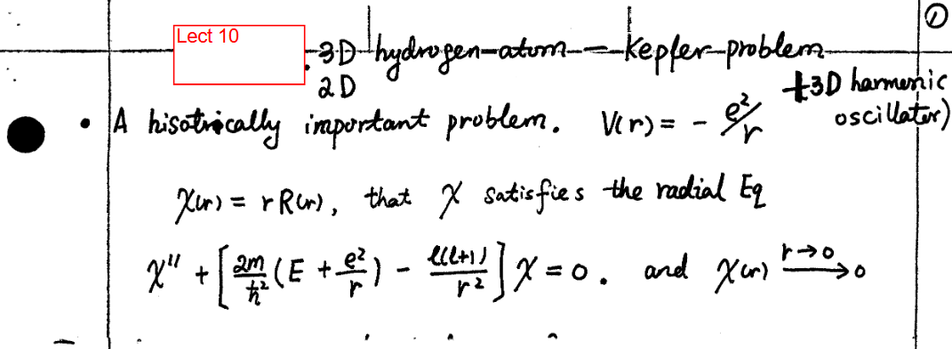
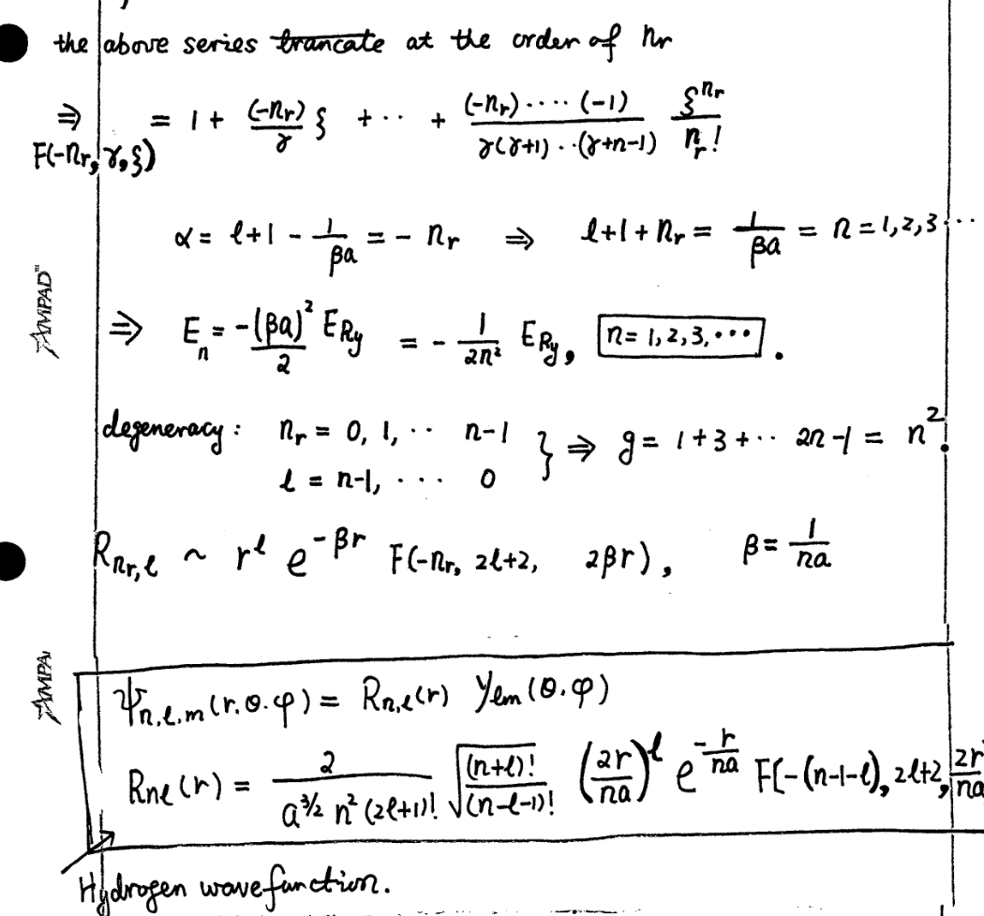
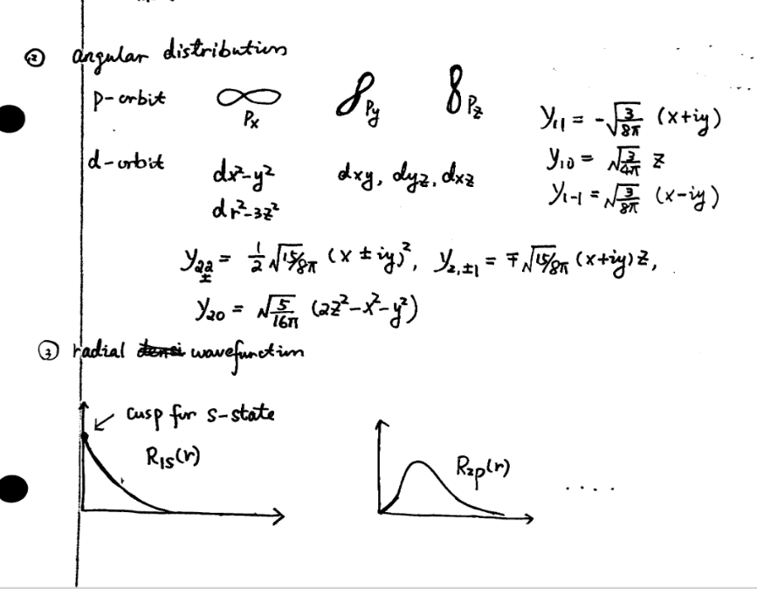
Triumph of Quantum Mechanics
Notes:
既然电子是波，那就要有个波动方程，就像水波和电磁波一样。这个工作是薛定谔在1926年完成的。他采用了物理学家所熟悉的数学工具—微分方程，构造了薛定谔方程，创立了波动力学。他也求解了氢原子的电子能级，能级对应于物质波的本征频率，也和实验符合的很好。
那物质波到底是个什么波呢？这个问题是玻恩解决的，物质波被解释成几率波。电子在某处出现的几率，是物质波振幅的绝对值平方。值得指出的是，在薛定谔方程中，物质波是复值的，这是复数第一次在实质意义上进入物理学。在经典物理中，我们也经常用复数，比如交流电，但这只是数学的方便。
薛定谔方程和物质波的概念取得了巨大的成功。人们解出了原子轨道结构。电子云的概念就是电子的几率分布。元素周期表的排列就不再基于化学性质的归纳了，其底层是量子力学。化学键理论得到了发展，分子物理，固体物理学得到了发展。其中半导体物理就是固体物理的分支，是现代芯片工业的基础。这一切，都离不开量子力学。

Slide 3
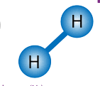
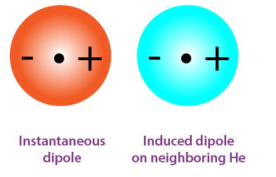
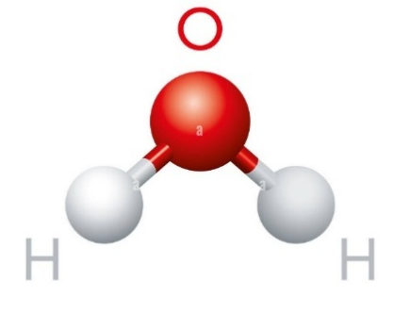
What is next for the development of QM?
From atom to quark → nuclear physics, quantum field theory, etc
From atom to chemistry (molecules) and condensed matter physics (solids)
Notes:
既然电子是波，那就要有个波动方程，就像水波和电磁波一样。这个工作是薛定谔在1926年完成的。他采用了物理学家所熟悉的数学工具—微分方程，构造了薛定谔方程，创立了波动力学。他也求解了氢原子的电子能级，能级对应于物质波的本征频率，也和实验符合的很好。
那物质波到底是个什么波呢？这个问题是玻恩解决的，物质波被解释成几率波。电子在某处出现的几率，是物质波振幅的绝对值平方。值得指出的是，在薛定谔方程中，物质波是复值的，这是复数第一次在实质意义上进入物理学。在经典物理中，我们也经常用复数，比如交流电，但这只是数学的方便。
薛定谔方程和物质波的概念取得了巨大的成功。人们解出了原子轨道结构。电子云的概念就是电子的几率分布。元素周期表的排列就不再基于化学性质的归纳了，其底层是量子力学。化学键理论得到了发展，分子物理，固体物理学得到了发展。其中半导体物理就是固体物理的分支，是现代芯片工业的基础。这一切，都离不开量子力学。

Slide 4
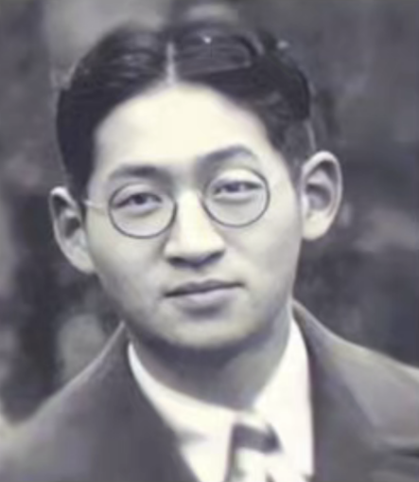
Shou-chin Wang (1904-1984)
1922—1924 Tsinghua College
1926—1928 Ph.D. in Physics at Columbia University
1928—1929 Postdoctoral researcher at Univ. of Wisconsin
1929—1933 Professor of Physics in Zhejiang University and Peking University
王守竞（S.C.Wang)
1933 —1944 For resistance to the Japanese invasion, he joined the defense industry and becamed a pioneer of mechanical industry of China.
1944 — 1949 Worked for the Chinese Embassy in the U. S.
1949 — 1969 Worked in MIT Lincoln Laboratory in the U.S.
1984 passed away in the U.S.
Notes:
Shou-chin Wang received pre-university level education at Tsinghua college, the forerunner of Tsinghua University. Then he went to U.S. to study physics in different places including Harvard and Columbia. He received Ph. D degree at Columbia for his work on hydrogen molecules. He went to University of Wisconsin for his postdoctoral research. His contributions to quantum chemistry were done during his stay in Columbia and Univ of Wisconsin.
After he returned China, he only stayed in academia for a short time. At that time China was in a very difficult time facing Japan’s invasion. Then he joined the defense industry for resisting Japanese invasion and became a pioneer of mechanical industry during the period of WWII.

Slide 5
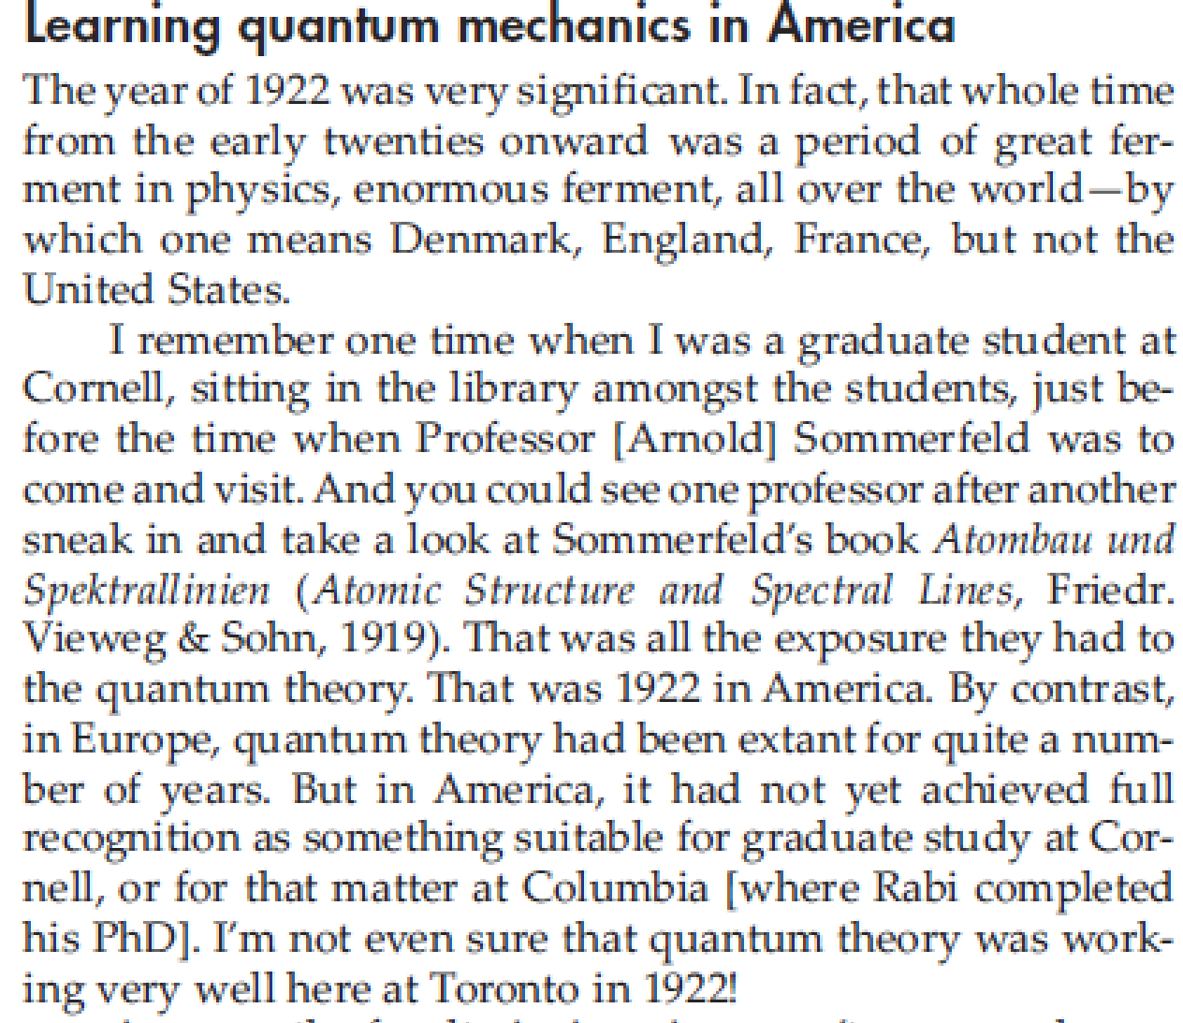
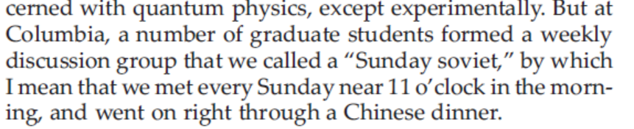
Quan-Mech Study Group at Columbia
Rabi, “Speech at Univ. of Toronto in 1972”, Physics Today, August 2006
Notes:
During his Ph. D. period at Columbia, Shou-chin Wang was a regular member of the Quantum-Mechanics study group. Rabi gave a speech in 1970’s. He recalled that in the late 1920’s, quantum mechanics was not paid much attention in the US. Yong students at Columbia organized a study group and studied QM together. In this photography of the study group, you can see Shou-Chin Wang, Kronig, Schwarzschild, Zemansky, Rabi et al.

Slide 6
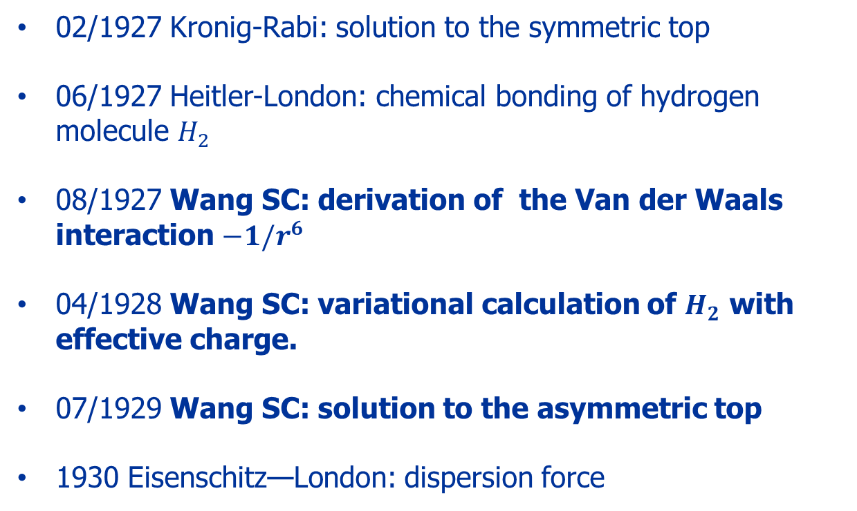
Early works on quantum chemistry
02/1927 Kronig-Rabi: solution to the symmetric top
06/1927 Heitler-London: chemical bonding of hydrogen molecule $H_{2}$
08/1927 Wang SC: derivation of the Van der Waals interaction $−1/r^{6}$
04/1928 Wang SC: variational calculation of $H_{2}$ with effective charge.
07/1929 Wang SC: solution to the asymmetric top
1930 Eisenschitz—London: dispersion force
S. C. Wang: strong competitor to F. London in late 1920’s
Notes:
The first success of QM was solving hydrogen atom. The next step would be solving molecules. Here is a list of early works of quantum chemistry. Shou-chin Wang’s record is outstanding.
I noticed that Shou-chin Wang was a strong competitor to Friz London. He was the first person that derived the 1/r^6 attraction between two neutral atoms. Later on, London improved Wang’s result, but it is now named as London dispersion force. I feel that Wang and London should share the credit. Wang’s work on hydrogen atom was later than Heitler-London, but with significant improvement by introducing an effective nuclear charge. Probably, Wang’s best-known result was the solution to asymmetric top which is important to the rotational spectra of molecules such as H2O.

Slide 7
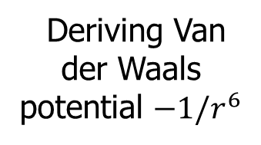
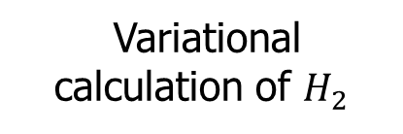
Variational calculation of $H_{2}$
S. C. Wang, Phys. Rev. 31, 579 (1928)
S. C. Wang, Physik. Zeitschrift 28, 663 (1927)
Shou-chin Wang (王守竞）
Deriving Van der Waals potential $−1/r^{6}$
Spectrum of the asymmetric top
S. C. Wang, Phys. Rev. 34, 243 (1929)
Notes:
Next I introduce Shou-chin Wang’s work on H2 molecules.

Slide 8
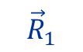
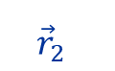
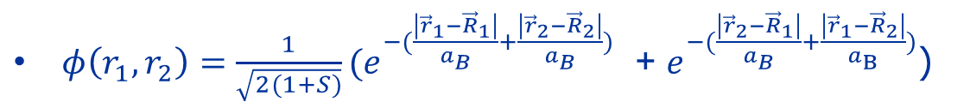
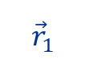


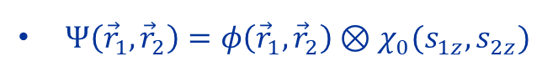
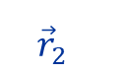
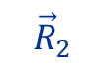
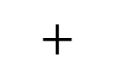
Heitler-London (1927): Hydrogen molecule
$H^{ }=−\frac{ℏ^{2}}{2m}{(∇}_{1}^{2}+∇_{2}^{2})−\frac{e^{2}}{\left|{\vec{r}}_{1}−{\vec{R}}_{1}\right|}−\frac{e^{2}}{\left|{\vec{r}}_{2}−{\vec{R}}_{2}\right|}−\frac{e^{2}}{\left|{\vec{r}}_{1}−{\vec{R}}_{2}\right|}−\frac{e^{2}}{\left|{\vec{r}}_{2}−{\vec{R}}_{1}\right|}$ $+\frac{e^{2}}{\left|{\vec{r}}_{1}−{\vec{r}}_{2}\right|}$+ $\frac{e^{2}}{\left|{\vec{R}}_{1}−{\vec{R}}_{2}\right|}$
$Ψ\left({\vec{r}}_{1},{\vec{r}}_{2}\right)=φ\left({\vec{r}}_{1},{\vec{r}}_{2}\right)⊗χ_{0}(s_{1z},s_{2z})$
$$−$$
$φ\left(r_{1},r_{2}\right)=\frac{1}{\sqrt{2(1+S)}}(e^{−(\frac{\left|{\vec{r}}_{1}−{\vec{R}}_{1}\right|}{a_{B}}+\frac{\left|{\vec{r}}_{2}−{\vec{R}}_{2}\right|}{a_{B}})}$ + $e^{−(\frac{\left|{\vec{r}}_{2}−{\vec{R}}_{1}\right|}{a_{B}}+\frac{\left|{\vec{r}}_{1}−{\vec{R}}_{2}\right|}{a_{B}})}$)
$${\vec{r}}_{1}$$
$${\vec{r}}_{2}$$
$${\vec{r}}_{2}$$
$${\vec{r}}_{1}$$
$$+$$
$${\vec{R}}_{1}$$
$${\vec{R}}_{2}$$
Notes:
This problem was first solved by Heitler-London, which is a historic work on the covalent chemical bond. Their solution was based on the 1s orbital wavefunction of hydrogen atom. According to Pauli’s exclusion principle, the ground state is a spin singlet such that the spatial wavefunction needs to be symmetrized under exchanging the coordinates of two electrons. They calculated the energy curve as a function of the distance between two nuclei. The energy minimum corresponds to the formation of a stable molecule. .

Slide 9
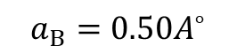
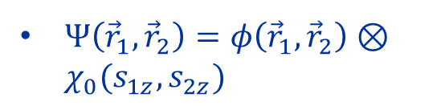

Heitler-London (1927): Hydrogen molecule
$Ψ\left({\vec{r}}_{1},{\vec{r}}_{2}\right)=φ\left({\vec{r}}_{1},{\vec{r}}_{2}\right)⊗χ_{0}(s_{1z},s_{2z})$
$$a_{B}=0.50A^{∘}$$
W. Heitler and F. London, Z. Phys. 44, 455 (1927)
Y. Sugiura, Z. Phys. 44, 190(1927)
$${l=|\vec{R}}_{1}−{\vec{R}}_{2}|$$
Notes:
This problem was first solved by Heitler-London, which is a historic work on the covalent chemical bond. Their solution was based on the 1s orbital wavefunction of hydrogen atom. According to Pauli’s exclusion principle, the ground state is a spin singlet such that the spatial wavefunction needs to be symmetrized under exchanging the coordinates of two electrons. They calculated the energy curve as a function of the distance between two nuclei. The energy minimum corresponds to the formation of a stable molecule. .

Slide 10
Linus Pauling: The nature of chemical bond
Notes:
Here are the comments from Pauling’s textbook, `Nature of Chemical bonds”. Heitler, London and later Sugiura’s calculations yield 67% of the binding energy of $H_{2}$ molecule, the bond length is larger than the experiment value. The main problem is that they directly used the hydrogen atom orbitals, such that their results violet the virial theorem. Wang improved this result such that the calculated binding energy reaches 80%. More importantly, the virial theorem is maintained in Wang’s calculation.

Slide 11
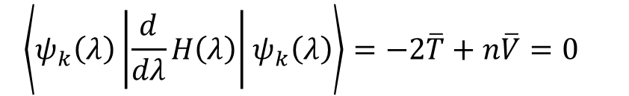
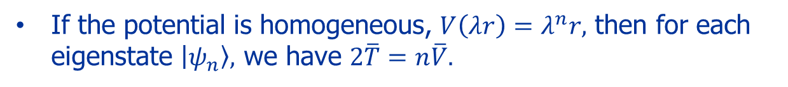
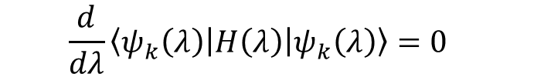
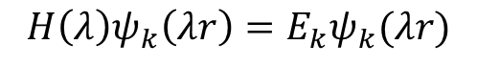
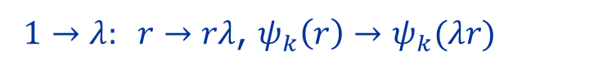
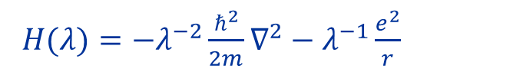

Virial theorem
If the potential is homogeneous, $V\left(λr\right)=λ^{n}r,$ then for each eigenstate $\left|ψ_{n}\right\rangle ,$ we have $2\overline{T}=n\overline{V}.$
$H(λ)=−λ^{−2}\frac{ℏ^{2}}{2m}∇^{2}−λ^{−1}\frac{e^{2}}{r}$
$1→λ: r→rλ$, $ψ_{k}\left(r\right)→ψ_{k}(λr)$
$${H\left(λ\right)ψ_{k}\left(λr\right)=E}_{k}ψ_{k}(λr)$$
$${\frac{d}{dλ}\left\langle ψ_{k}\left(λ\right)\left|H\left(λ\right)\right|ψ_{k}\left(λ\right)\right\rangle =0 }_{ }$$
Feynman-Hellman theorem
$${\left\langle ψ_{k}\left(λ\right)\left|\frac{d}{dλ}H\left(λ\right)\right|ψ_{k}\left(λ\right)\right\rangle =−2\overline{T}+n\overline{V}=0 }_{ }$$
Generalizable to many-particle system:
$$H=\sum_{i}{T_{i}}+\sum_{ij}{ }V\left(r_{i}−r_{j}\right).$$
Notes:
This problem was first solved by Heitler-London, which is a historic work on the covalent chemical bond. Their solution was based on the 1s orbital wavefunction of hydrogen atom. According to Pauli’s exclusion principle, the ground state is a spin singlet such that the spatial wavefunction needs to be symmetrized under exchanging the coordinates of two electrons. They calculated the energy curve as a function of the distance between two nuclei. The energy minimum corresponds to the formation of a stable molecule. .

Slide 12

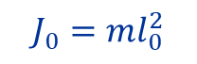
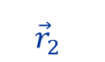

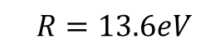
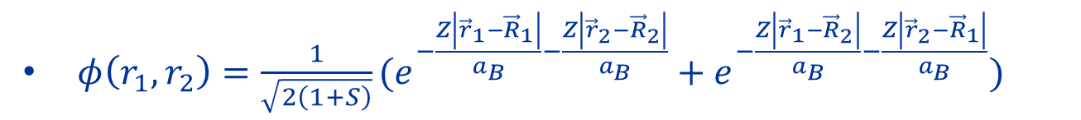
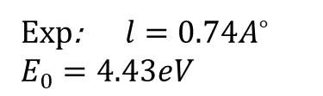
S. C. Wang (1928): Effective charge $Z=1.166$
$φ\left(r_{1},r_{2}\right)=\frac{1}{\sqrt{2\left(1+S\right)}}(e^{−\frac{Z\left|{\vec{r}}_{1}−{\vec{R}}_{1}\right|}{a_{B}}−\frac{Z\left|{\vec{r}}_{2}−{\vec{R}}_{2}\right|}{a_{B}}}+e^{−\frac{Z\left|{\vec{r}}_{1}−{\vec{R}}_{2}\right|}{a_{B}}−\frac{Z\left|{\vec{r}}_{2}−{\vec{R}}_{1}\right|}{a_{B}}})$
$${\vec{r}}_{1}$$
$${\vec{r}}_{2}$$
$${l=|\vec{R}}_{1}−{\vec{R}}_{2}|$$
$$J_{0}=ml_{0}^{2}$$
Exp: $l=0.74A^{∘}$
$$E_{0}=4.43eV$$
$${\vec{R}}_{1}$$
$${\vec{R}}_{2}$$
$$R=13.6eV$$
S. C. Wang, Phys. Rev 31, 579(1928)
Notes:
Because there exist two nuclei, the radius of the 1s atomic orbital changes. Wang introduced an effective charge Z to describe this effect and treated Z as an additional variational parameter. This is a table from Wang’s paper. He solved that the optimized value of Z is 1.16. You may notice Condon’s result is exceptionally good, but it is should be taken so seriously.

Slide 13
Linus Pauling: The nature of chemical bond
Notes:
Again, according to Pauling, Condon used the method of molecular orbital method in today’s terminology. Condon’s and H-L-W’s wavefunctions are exact in the weak and strong limits of electron-electron interactions, and the reality lies in the middle. Condon did not really evaluate the interaction energy by calculating Coulomb integrals but used a physical argument to extract the value by using the ratio between kinetic and interaction energies in He.

Slide 14
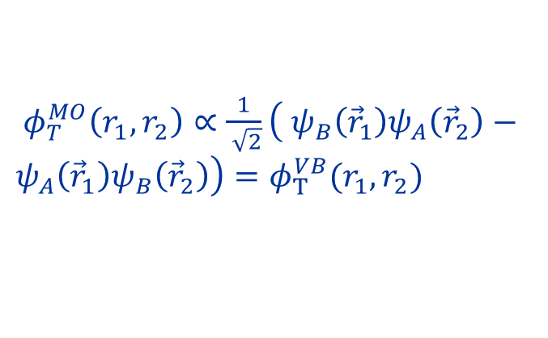
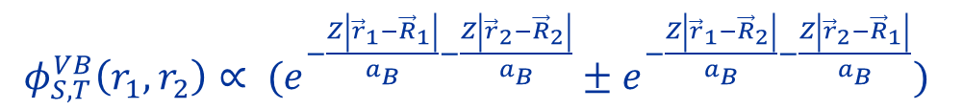
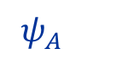

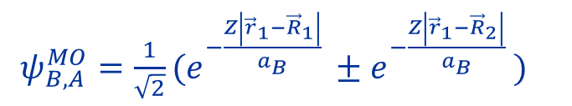

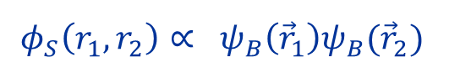

Valence bond and molecular orbital
Valence bond
$φ_{S,T}^{VB}\left(r_{1},r_{2}\right)∝ (e^{−\frac{Z\left|{\vec{r}}_{1}−{\vec{R}}_{1}\right|}{a_{B}}−\frac{Z\left|{\vec{r}}_{2}−{\vec{R}}_{2}\right|}{a_{B}}}±e^{−\frac{Z\left|{\vec{r}}_{1}−{\vec{R}}_{2}\right|}{a_{B}}−\frac{Z\left|{\vec{r}}_{2}−{\vec{R}}_{1}\right|}{a_{B}}})$
Molecular orbit
$ψ_{A}$
$ψ_{B,A}^{MO}=\frac{1}{\sqrt{2}}(e^{−\frac{Z\left|{\vec{r}}_{1}−{\vec{R}}_{1}\right|}{a_{B}} }±e^{−\frac{Z\left|{\vec{r}}_{1}−{\vec{R}}_{2}\right|}{a_{B}} })$
$ψ_{B}$
$φ_{S}\left(r_{1},r_{2}\right)∝ ψ_{B}\left({\vec{r}}_{1}\right)ψ_{B}({\vec{r}}_{2})$
$ψ_{A}$
$φ_{T}^{MO}\left(r_{1},r_{2}\right)∝\frac{1}{ \sqrt{2}}\left( ψ_{B}\left({\vec{r}}_{1}\right)ψ_{A}\left({\vec{r}}_{2}\right)−ψ_{A}\left({\vec{r}}_{1}\right)ψ_{B}\left({\vec{r}}_{2}\right)\right)=φ_{T}^{VB}(r_{1},r_{2})$
$ψ_{B}$
Notes:
Because there exist two nuclei, the radius of the 1s atomic orbital changes. Wang introduced an effective charge Z to describe this effect and treated Z as an additional variational parameter. This is a table from Wang’s paper. He solved that the optimized value of Z is 1.16. You may notice Condon’s result is exceptionally good, but it is should be taken so seriously.

Slide 15
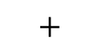
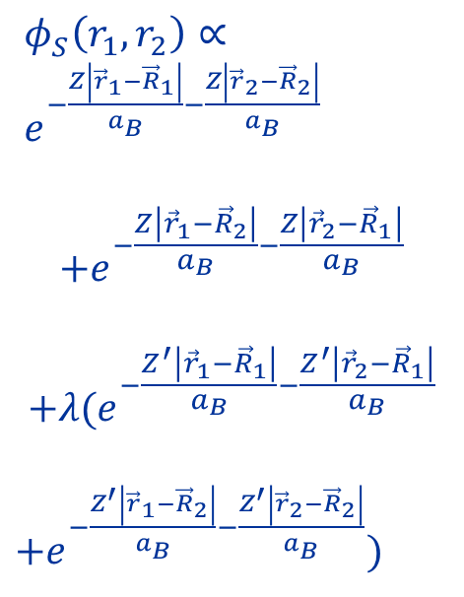
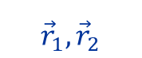





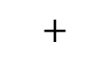

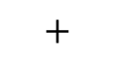
$${\vec{r}}_{1}$$
$${\vec{r}}_{2}$$
$φ_{S}^{ }\left(r_{1},r_{2}\right)∝ e^{−\frac{Z\left|{\vec{r}}_{1}−{\vec{R}}_{1}\right|}{a_{B}}−\frac{Z\left|{\vec{r}}_{2}−{\vec{R}}_{2}\right|}{a_{B}}}$
$$+e^{−\frac{Z\left|{\vec{r}}_{1}−{\vec{R}}_{2}\right|}{a_{B}}−\frac{Z\left|{\vec{r}}_{2}−{\vec{R}}_{1}\right|}{a_{B}}}$$
$$+λ(e^{−\frac{Z^{′}\left|{\vec{r}}_{1}−{\vec{R}}_{1}\right|}{a_{B}}−\frac{Z^{′}\left|{\vec{r}}_{2}−{\vec{R}}_{1}\right|}{a_{B}}}$$
$+e^{−\frac{Z^{′}\left|{\vec{r}}_{1}−{\vec{R}}_{2}\right|}{a_{B}}−\frac{Z^{′}\left|{\vec{r}}_{2}−{\vec{R}}_{2}\right|}{a_{B}}}$)
$$+$$
Heitler-London-Wang
$${\vec{r}}_{2}$$
$${\vec{r}}_{1}$$
$$+$$
$$λ$$
Molecular orbital
$${\vec{r}}_{1}, {\vec{r}}_{2}$$
$$+$$
$$λ$$
$0<λ$<1
$${\vec{r}}_{1}, {\vec{r}}_{2}$$
Notes:
Because there exist two nuclei, the radius of the 1s atomic orbital changes. Wang introduced an effective charge Z to describe this effect and treated Z as an additional variational parameter. This is a table from Wang’s paper. He solved that the optimized value of Z is 1.16. You may notice Condon’s result is exceptionally good, but it is should be taken so seriously.

Slide 16
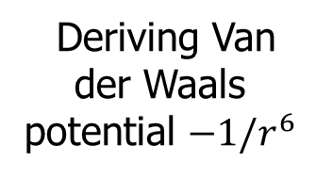
Variational calculation of $H_{2}$
S. C. Wang. Phys. Rev. 31, 579 (1928)
S. C. Wang, Physik. Zeitschrift 28, 663 (1927)
Shou-chin Wang (王守竞）
Deriving Van der Waals potential $−1/r^{6}$
Spectrum of the asymmetric top
S. C. Wang, Phys. Rev. 34, 243 (1929)
Notes:
Second, I briefly introduce Shou-chin Wang’s work on the van der Waals interaction.

Slide 17


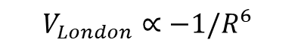
Intermolecular forces
Keesom interaction: between two molecules with permanent dipole moments
$$V_{dp}∝1/R^{3}$$
Debye force : A molecule with permanent dipole can induce a dipole in a similar neighboring molecule and cause mutual attraction
$$V_{debye}∝−1/R^{6}$$
London dispersion force: attractive force between to neutral molecules/atoms
$$V_{London}∝−1/R^{6}$$
Notes:
The intermolecular interactions typically can be classified as three classes. One the dipolar interaction between two molecules with permanent dipoles. It is well-known that it decays as 1/R^3. Furthermore, the electric field from the dipole can weakly polarize a non-polar object. The induced dipole itself scales as 1/R^3, hence, the interaction scales as 1/R^6, which is called the Debye force. The most subtle one is the interaction between two non-polar atoms or molecules. Naively they should have no interaction, but there exists an attraction of 1/R^6. This problem was first solved by Shou-chin Wang quantum mechanically, even though it is named London dispersion force in literature.
.

Slide 18
J. S. Rowlinson – Cohesion A scientific history of intermolecular forces, Cambridge Univ Press (2002)
S. C. Wang, Physik. Zeitschrift 28, 663 (1927)
Notes:
This textbook presents a relatively fair description to the actual history. During Debye’s visit to Columbia, he persuaded Shou-Chin Wang to solve this problem, and Wang derived the attraction of the r^-6 behavior.

Slide 19
J. S. Rowlinson – Cohesion A scientific history of intermolecular forces, Cambridge Univ Press (2002)
R. Eisenschitz and F. London, Z. Phys. 60, 491 (1930)
Notes:
Three years later, London and his collaborator reexamined this problem. Basically, they arrived at the same power of -6 and further improved the value of the coefficient. It is fair to say that the correctness of the decay power is more important than the quantitative value of the coefficient. Hence, I feel that Wang should receive his credit.

Slide 20
S. C. Wang: Physik. Zeitschrift 28, 663 (1927)
I would like to thank Prof. Debye for the suggestion to study the present problem and his friendly interest during the implementation of this research.
Notes:
This is Shou-chin Wang’s original paper published in German. This term represents the interaction between two instantaneous dipoles separated at a long distance R. At the end of the paper, Wang acknowledged Debye’s suggesting to him to work on the problem.

Slide 21
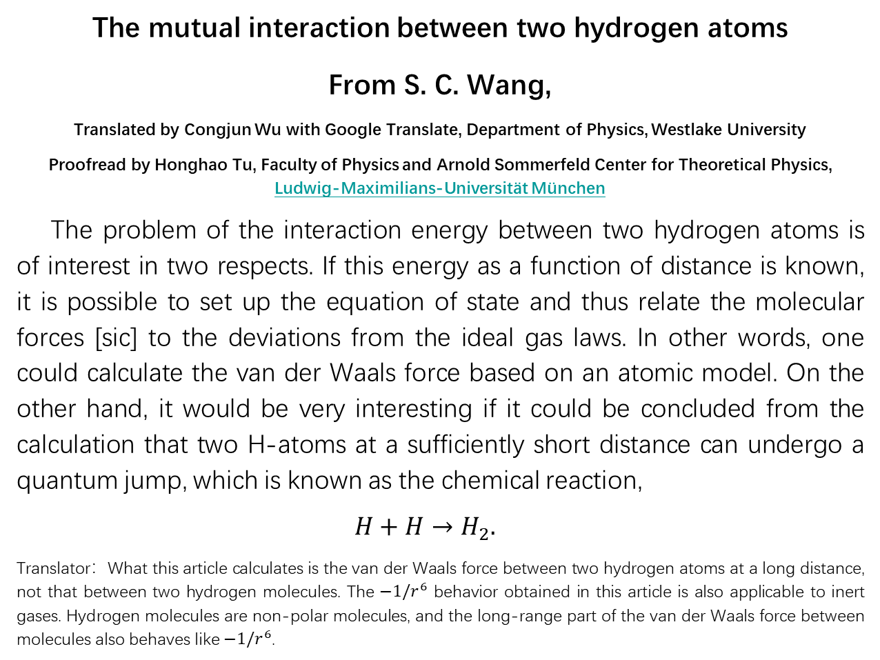
英文译稿被《物理学进展》接受，将于2025年12月
The mutual interaction between two hydrogen atoms
From S. C. Wang,
Translated by Congjun Wu with Google Translate, Department of Physics, Westlake University
Proofread by Honghao Tu, Faculty of Physics and Arnold Sommerfeld Center for Theoretical Physics, Ludwig-Maximilians-Universität München
The problem of the interaction energy between two hydrogen atoms is of interest in two respects. If this energy as a function of distance is known, it is possible to set up the equation of state and thus relate the molecular forces [sic] to the deviations from the ideal gas laws. In other words, one could calculate the van der Waals force based on an atomic model. On the other hand, it would be very interesting if it could be concluded from the calculation that two H-atoms at a sufficiently short distance can undergo a quantum jump, which is known as the chemical reaction,
$H+H→H_{2}.$
Translator：What this article calculates is the van der Waals force between two hydrogen atoms at a long distance, not that between two hydrogen molecules. The $−1/r^{6}$ behavior obtained in this article is also applicable to inert gases. Hydrogen molecules are non-polar molecules, and the long-range part of the van der Waals force between molecules also behaves like $−1/r^{6}$.
Notes:
I did not find the English translation of Shou-chin Wang’s paper. I wonder if this is partly the reason that his work is largely neglected. Then I use translate it into English under Google translate line by line. It is proofread by my friend Honghao Tu, who is a physics professor in Germany.

Slide 22
中文译稿被《大学物理》接收
Notes:
Based on the English version I also translate it into Chinese.

Slide 23
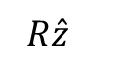
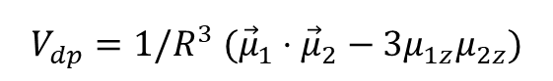
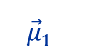
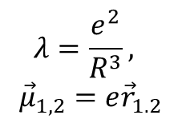

2nd order perturbation theory
$${\vec{μ}}_{2}$$
-
+
$$V_{dp}=1/R^{3} ({\vec{μ}}_{1}⋅{\vec{μ}}_{2}−3μ_{1z}μ_{2z})$$
$$λ=\frac{e^{2}}{R^{3}},$$
$${\vec{μ}}_{1,2}=e{\vec{r}}_{1.2}$$
$$R\hat{z}$$
$${\vec{μ}}_{1}$$
-
+
S. C. Wang, Physik. Zeitschrift 28, 663 (1927)
Notes:
How did Shou-chin Wang study this problem? Basically, he treated dipolar interaction as perturbation. On average, each atom is non-polar, but at each moment, there exists an instantaneous dipole in each atom. Two instantaneous dipoles interact with each other, and their motions are correlated. Wang used the 2nd order perturbation theory to calculate the ground state energy shift. Since it was quite early in history, the version he used was different from what we teach in today’s quantum mechanics textbooks.

Slide 24







Simplified demonstration
$$V_{dp}=1/R^{3} ({\vec{μ}}_{1}⋅{\vec{μ}}_{2}−3μ_{1z}μ_{2z})$$
$${\vec{μ}}_{1,2}=e{\vec{r}}_{1.2}$$
$${\vec{μ}}_{2}$$
-
$${\left|G\right\rangle }_{0}={\left|s\right\rangle }_{1}⊗{\left|s\right\rangle }_{2}$$
+
$${\left|G\right\rangle }_{1}={\sum_{i=x,y,z}{ }\left|p_{i}\right\rangle }_{1}⊗{\left|p_{i}\right\rangle }_{2} \frac{⟨p_{i}{\left.​\right|}_{1}⊗\left\langle p_{i}{\left.​\right|}_{2}V_{dp} | G_{0}\right\rangle }{−2ΔE }$$
$$=−\frac{a^{3}}{R^{3}}(2 {\left|p_{z}\right\rangle }_{1}⊗{\left|p_{z}\right\rangle }_{2} −{\left|p_{x}\right\rangle }_{1}⊗{\left|p_{x}\right\rangle }_{2}{−\left|p_{y}\right\rangle }_{1}⊗{\left|p_{y}\right\rangle }_{2})$$
$$R\hat{z}$$
$$d=\left\langle p_{z}\left|z\right|s\right\rangle$$
define $a^{3}=\frac{e^{2}d^{2}}{2ΔE}∼a_{B}^{3}$
$${\vec{μ}}_{1}$$
-
$$ΔE^{\left(2\right)}∼−\frac{e^{2}a^{2}}{R^{3}}\frac{a^{3}}{R^{3}}∼−\frac{e^{2}a_{B}^{5}}{R^{6}}$$
+
Notes:
I try to use the modern language as a simplified demonstration. The 0th order ground state is a product state of both atoms are in the 1s state, and the 1st order perturbative wavefunction involves both atoms in the excited states to the p-levels. The ground state energy shift is at the 2nd order of interaction. Since the dipolar interaction itself decays as 1/R3, then the energy shift decays as 1/R6.

Slide 25




As a final result, we obtain that the mutual potential energy of two hydrogen atoms in the ground state and at a distance R has the value
$−\frac{243}{28}\frac{e^{2}a^{5}}{R^{6}}≈−8.7$ $\frac{e^{2}a^{5}}{R^{6}}$
Let us take two dipoles of moment $μ$ and with the polarization constant $α$ at a distance R. We assume that these dipoles take all possible orientations in space, so the mutual potential energy is
$$−2α\frac{μ^{2}}{R^{6}}$$
S. C. Wang, Physik. Zeitschrift 28, 663 (1927)
……the hydrogen atom in the ground state, $α=\frac{9}{2}a^{3}$, we can see that the mutual potential energy according to quantum theory can be interpreted in a classical way as the polarization effect that two atoms with the following value of dipole moment interacting with each other ,
$μ=0.982ea$
Notes:
These are results quoted from my English translation of Wang’s work. The qualitative decay power of 6 is correct. He also developed classic pictures to understand his quantum mechanical calculation.

Slide 26


Wang-London force
Pauling & Wilson Introduction to QM
S. C. Wang (Phys. Z, 1927) correctly understood that the Van de Waals potential between two atoms at far distance arises form the fluctuations of instantaneous dipole moments. He derived the correct decay power$1/r^{6}$
F. London’s work (Z. Phys. 1930) is a further development based on Wang’s. It is not so fair to emphasize that London obtained the correct coefficient.
Notes:
These are results quoted from my English translation of Wang’s work. The qualitative decay power of 6 is correct. He also developed classic pictures to understand his quantum mechanical calculation.

Slide 27

Variational calculation of $H_{2}$
S. C. Wang. Phys. Rev. 31, 579 (1928)
S. C. Wang, Physik. Zeitschrift 28, 663 (1927)
Shou-chin Wang (王守竞）
Deriving Van der Waals potential $−1/r^{6}$
Spectrum of the asymmetric top
S. C. Wang, Phys. Rev. 34, 243 (1929)
Notes:
The last one is Shou-chin Wang’s most important work. He solves the energy spectrum of the asymmetric top, which is related to the rotational spectrum of molecules like water molecules.

Slide 28



Symmetric Top – Kronig, Rabi’s solution
Kronig, Rabbi, Phys. Rev. 29, 262 (1927)
Rabi, “Speech at Univ. of Toronto in 1972”, Physics Today, August 2006
Notes:
A simpler problem is the rotational energy spectrum of symmetric top molecules. This problem was solved before by Rabi and Kronig. It was the outcome of quantum mechanics study group at Columbia. In his speech in 1972, Rabi recalled that when he and Kronig tried to solve the energy spectrum of a symmetric top, they met a differential equation, which was so difficult that they could not solve.

Slide 29












Problem formulation
$H(α,β,γ)=\frac{Q_{1}^{2}}{2I_{ }}+\frac{Q_{2}^{2}}{2I_{ }}+\frac{Q_{3}^{2}}{2I_{3}}$
lab frame (${{\hat{x}}_{ },{\hat{y}}_{ }, {\hat{z}}_{ })}_{ }$
body-fixed frame (${{\hat{e}}_{1},{\hat{e}}_{2}, {\hat{e}}_{3})}_{ }$
$g$: orth. matrix $\left(α,β,γ\right):Euler angle$
Quan numbers: ($L^{2}, L_{z}, Q_{3})$
$$ψ_{ }\left(g\right)=ψ_{lmk}\left(α,β,γ\right)={(D}_{mk}^{l} {\left(α,β,γ^{ }\right))}^{∗}$$
$L_{z}=\vec{L}⋅\hat{z}$, $Q_{3}=\vec{L}⋅{\hat{e}}_{3}$
$${L_{ }^{2}ψ}_{lmk}=l\left(l+1\right)ℏ^{2}ψ_{lmk}$$
$$\left( \frac{1}{sinβ}\frac{d}{dβ}sinβ\frac{d}{dβ}+l(l+1)−\frac{m^{2}+k^{2}−2mkcosβ}{\sin^{2}{β}}\right)d_{mk}^{l}(β)=0$$
$$L_{z}ψ_{lmk}=mℏψ_{lmk},$$
$$Q_{3}ψ_{lmk}=kℏ ψ_{lmk}$$
$$−l≤m,k≤l$$
Wigner D-matrix: $L_{z}=\vec{L}⋅\hat{z}$, $Q_{3}=\vec{L}⋅{\hat{e}}_{3}$
Notes:
This problem can be formulated as follows: We need two sets of reference frames to describe a rigid body rotation. The fixed lab frame (x,y,z), and the body-fixed frame (e1,e2,e3) which are principal axes of the rigid body. The rigid body Hamiltonian is expressed through the angular momentum projection to the body-fixed frame, which are represented by Euler angles and their derivatives. For a symmetric top, there exist three good quantum numbers, the total angular momentum L, angular momentum projection to the Lab frame z-axis denoted by m, and the angular momentum projection to the body frame e3 denoted as k. k represents the rotation around its symmetry axis, that is, the spinning of the top. The differential equation that Rabi faced is right here. If k=0, i.e., there is no spinning around the symmetric axis, its solution is reduced to spheric harmonic functions. But when top is spinning, this equation is difficult.

Slide 30



Jacobi polynomial
$$P_{n}^{\left(α,β\right)}\left(x\right)=\frac{{\left(−\right)}^{n}}{2^{n}n!}{\left(1−x\right)}^{−α}{\left(1+x\right)}^{−β}\frac{d^{n}}{dx^{n}}\left({\left(1−x\right)}^{α+n}{\left(1+x\right)}^{β+n}\right)$$
$E_{lk}^{s}=ℏ^{2}(\frac{1}{2I}l(l+1)+\frac{1}{2}\left(\frac{1}{I_{3}}−\frac{1}{I}\right)k^{2}), (−l≤m≤l$）
For each $k$, there exist a set of $(l, m)$ multiplets.
The multiplets with $±k$ are also degenerate.
Notes:
Then Rabi found the solution is in fact in Carl Jacobi’s book. The solution is related to Jacobi polynomial, and then energy eigenvalues can be easily obtained. The energy depends on total angular momentum l, and how the top spins as reflected by k. For each value of k, there exist a 2l+1 fold degenerate multiplet due to angular momentum conservation.

Slide 31

Shou-Chin Wang (1929) Asymmetric Top
Notes:
But for asymmetric tops, the solutions are much more difficult. In fact, most molecules are asymmetric tops. For example, the water molecule. This problem was finally solved by Shou-chin Wang during his postdoc time at University of Wisconsin.

Slide 32
Matrix mechanics formulation
S. C. Wang, Phys. Rev. 34, 243 (1929)
Notes:
Shou-chin Wang expressed that it is difficult to separate variables. Instead, he used the algebraic method of the matrix mechanics representation.

Slide 33





Secular Equation
$H\left(α,β,γ\right)=\frac{Q_{1}^{2}}{2{I_{1}}_{ }}+\frac{Q_{2}^{2}}{2{I_{2}}_{ }}+\frac{Q_{3}^{2}}{2I_{3}}=H_{0}+H_{diag}+H_{off}$
$H_{0}$=$aL^{2}, H_{diag}=bQ_{3}^{2}, H_{off }^{ }=c\left(Q_{+}^{2}+Q_{−}^{2}\right)$
${a=\frac{1}{2}\left(\frac{1}{{2I}_{1}}+\frac{1}{{2I}_{2}}\right)}^{ }$, $b=\frac{1}{{2I}_{3}}−a$, $c=\frac{1}{4}\left(\frac{1}{2I_{1}}−\frac{1}{{2I}_{2}}\right)$
|$ψ_{lmk}⟩$ as basis → secular matrix elements
$$\left\langle l^{′}m^{′},k^{′}\left|H_{diag}\right|lmk\right\rangle =δ_{ll^{′}}δ_{mm^{′}}δ_{kk^{′}}bk^{2}$$
$\left\langle l^{′}m^{′},k∓2\left|H_{off}^{ }\right|lmk\right\rangle =cℏ^{2}{\left(\left(l±k\right)\left(l∓k+1\right)\left(l±k−1\right)\left(l∓k+2\right)\right)}^{\frac{1}{2}}δ_{ll^{′}}δ_{mm^{′}}$
each level degenerate for $−l≤m≤l$
$$E_{lk}=ℏ^{2}\left(al\left(l+1\right)+λ_{k}\right)$$
Notes:
Shou-chin Wang used the symmetric topic solutions as basis, under which he construct the secular equation for the asymmetric top Hamiltonian. The off-diagonal terms describe the asymmetry part. States with different quantum numbers of k are connected. Wang derived the off-diagonal matrix elements by using the analytic method. It could be simplified by using purely algebraic methods.

Slide 34
Notes:
This is the secular equation that Shou-ching Wang derived. It can be further decomposed into 2 sectors with even and odd values of k quantum numbers, respectively. Diagonalizing these matrices, we arrive the spectra of asymmetric top as shown in Eq. 10.

Slide 35







The $σ$-doubling phenomena
$I_{3}≪I_{2}≲I_{1}$ → $H_{diag}$ as perturbationon
0th order: $E_{lk}^{0}=ℏ^{2}\left(al\left(l+1\right)+bk^{2})\right.$
$$E_{lk=0}^{0}<E_{lk=±1}^{0}<…<E_{lk=±l}^{0}$$
the degeneracy weakly lifted at the $k$-th order
$$ψ_{lmk,±}=\frac{1}{ \sqrt{2}}\left(ψ_{lmk}±ψ_{lm−k}\right)$$
Notes:
When the asymmetry is small, the spectra exhibit the so-called sigma doubling phenomena. For symmetric tops, there should be generate doublets for positive and negative values of k. The asymmetry of top breaks this degeneracy leading to the doubling phenomena, dubbed the sigma doubling.

Slide 36
Herzberg G. Molecular Spectra and Molecular Structure, Volume II. New York：
D. van Nostrand Company，1945. pp. 46—49
Notes:
This work of Shou-chin Wang is well-recognized in literature. In this celebrated monograph, “Molecular spectra and molecular structure”, Wang’s formula is highlighted.

Slide 37


余少川，《中国机械工业的拓荒者—王守竞》第一版，云南大学出版社（2003）
Notes:
Shou-chin Wang returned to China in 1929. China was in danger of the Japanese invasion. He left academia and joined the defense industry and led the mechanical industry of China during WWII. He is honored as the pioneer of mechanical industry of China. These pictures show the products of the factory during the war time.

Slide 38

Summary
02/1927 Kronig-Rabi: solution to symmetric top
06/1927 Heitler-London: chemical bonding of hydrogen molecule
08/1927 Wang SC: derived Van der Waals potential $−1/r^{6}$
04/1928 Wang SC: variational calculation of Hydrogen molecule
07/1929 Wang SC: solution to asymmetric top
1930 Eisenschitz—London: dispersion force
Notes:
Here is the summary of the early works of quantum chemistry. Shou-chin Wang was one of the leaders in this field at that time. He did these works in the US, and U.S. was not the center of quantum physics at that time. He has three representative works. He is best-known for his formula solving the spectrum of asymmetric top. He was the first person to derive the 1/r^6 attraction between non-polar atoms in the quantum mechanical way, but this work is largely neglected. Personally, I feel that the London dispersion force should be called the Wang-London force.

Slide 40


中国机械工业的拓荒者
P
Notes:
Even within the Chinese physics community, Shou-chin Wang’s works are not well-known. Nevertheless there are still a few introductions to him. Professor Danian Hu gave a talk in APS march meeting introducing Wang’s career and contributions to quantum mechanics. Professor Shenhua Hu wrote an article on Shou-chin Wang’s scientific works. Here is a biography of Wang which on another side of his life. He was the pioneer of mechanical industry during the WWII, or, the war of resistance to Japanese invasion.

